Slide 1
Convolutional Neural Networks(CNN)

Slide 2
Contents
Brief introduction to CNN
Constituents of CNN
Putting it all together with an example

Slide 3
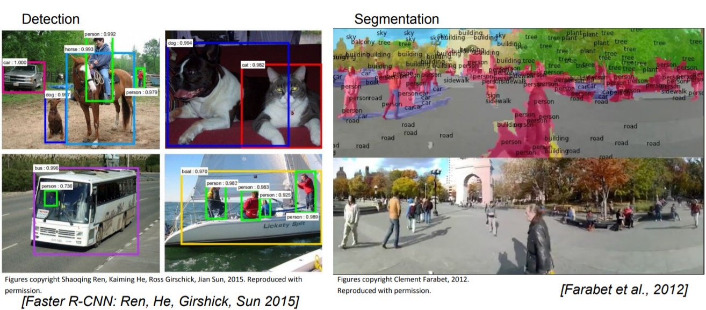
CNN is Everywhere

Slide 4
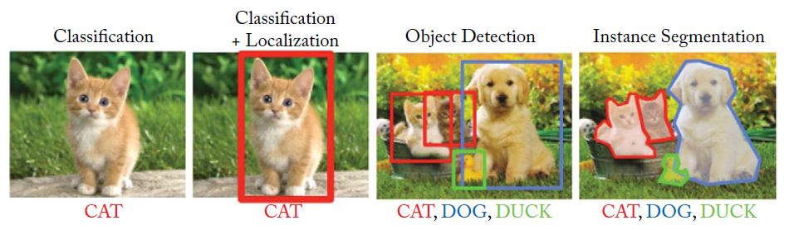
Computer Vision Problems

Slide 5
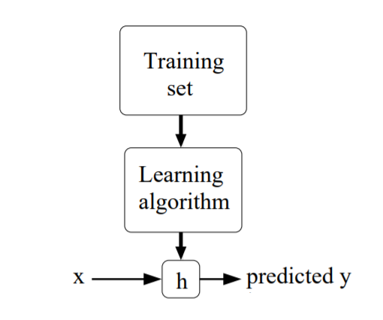
Supervised Learning
Training Set: is a list of training examples
Training example: is an ordered pair (input variable, output variable)
The algorithm is trained using the training set.
The goal is, given a training set, to learn a function h : X → Y so that h(x) is a “good” predictor for the corresponding value of y. Function h is called a hypothesis.
X: space of input values
Y: space of output values

Slide 6
Classification
If the output values to be predicted are discrete
Like predicting the types of fruits
Types:
Binary Classification
Multiclass classification

Slide 7
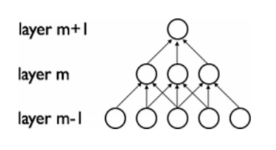
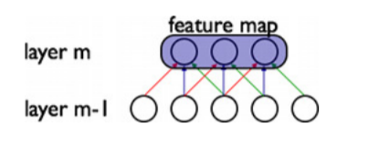
CNN- feedforward neural network with a special structure
Sparse local connectivity between layers (except the last output layer). Reduces the number of parameters to be learned
Shared weights : Neurons in one layer have the same weights. Helps capture the local properties of the signal

Slide 8
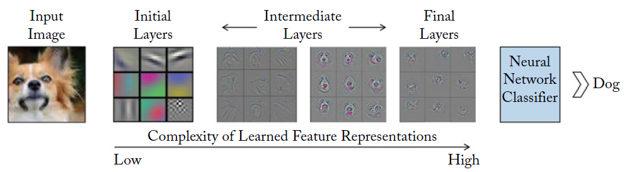
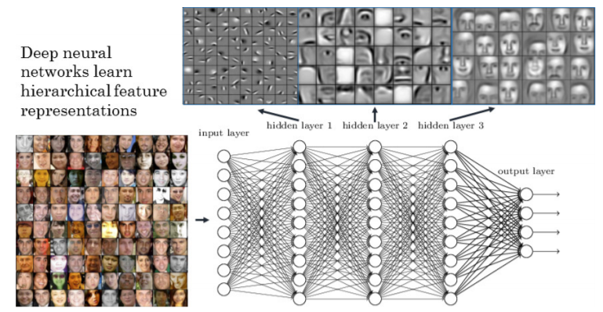

Slide 9
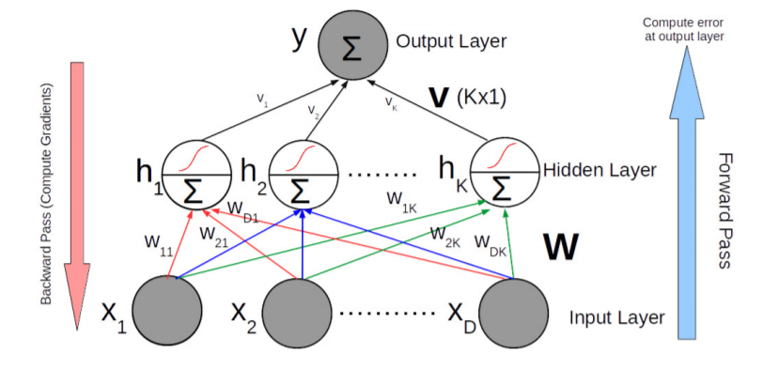
Training CNN
Use backpropagation algorithm
Consists of a forward pass and a backward pass
Forward pass computes the errors using the current parameters
Backward pass computes the gradients and updates the parameters, starting from the parameters at the top layer and then moving backwards

Slide 10
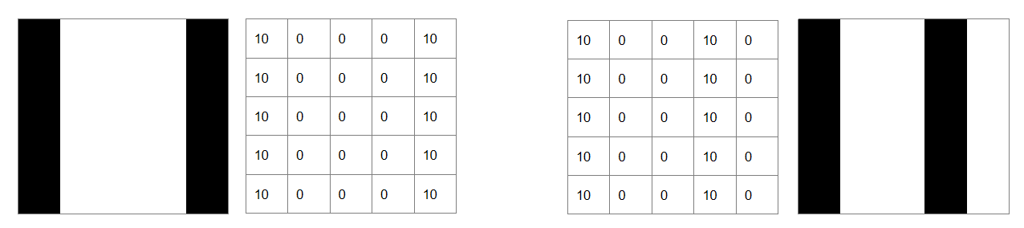
Data for CNN
CNN works on data input that can be represented as a grid
Because CNN searches for patches of data to match in given input for classification
The data cells in the grid must have a sequence among them –Sequential data
Example:
Image of a certain height and width can be represented as a grid
The cells in the grid have pixel values in them
If we change the order of the rows and the columns, then the input will completely become different.

Slide 11
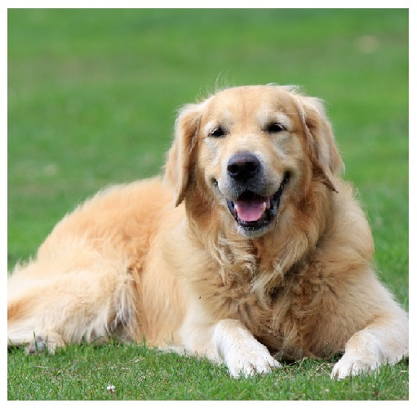
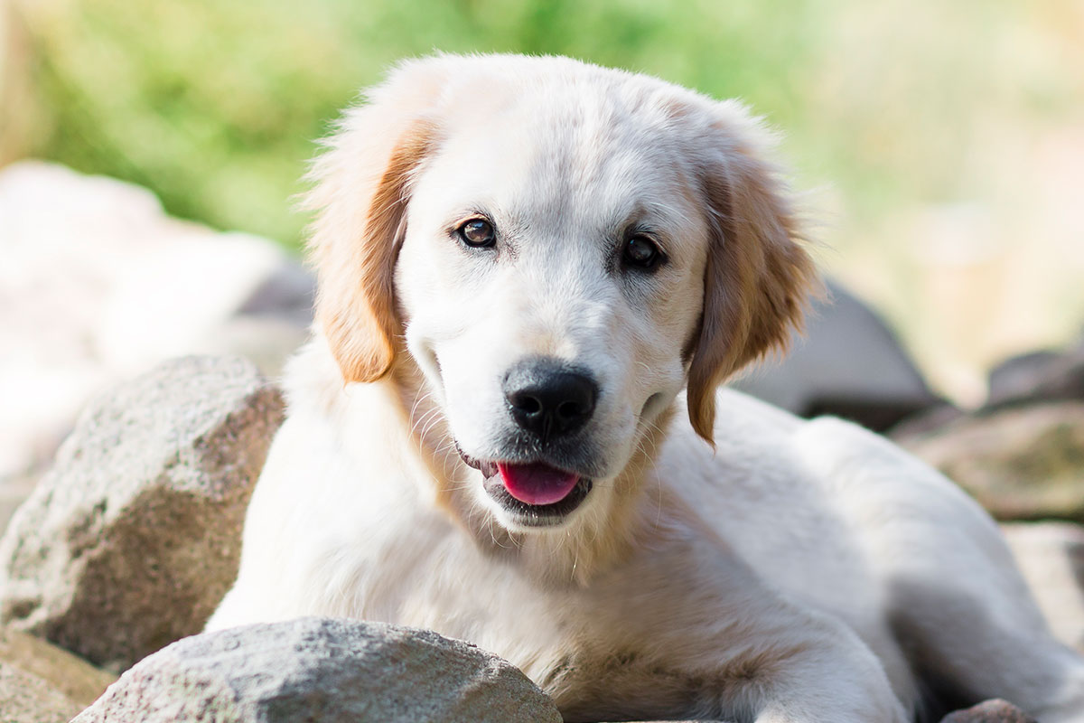
Need for CNN when number of features are large
To process such large number of parameters use CNN
60x60x3 image
10800 features
1000x1000x3 image
3 million features
3 billion parameters with 1000hidden layer neurons

Slide 12
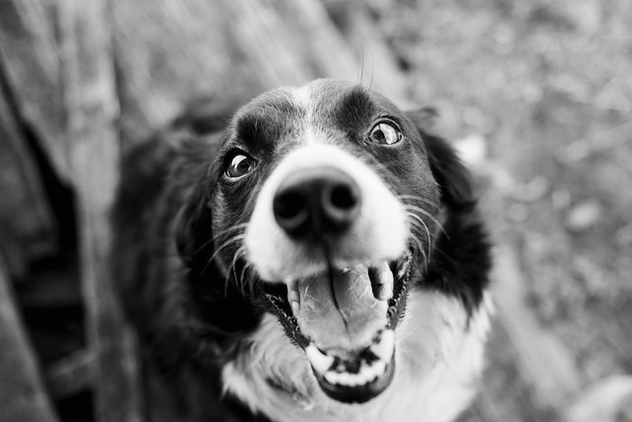
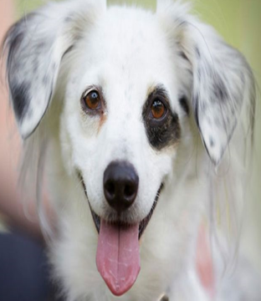
Examples of images- every pixel has a value
Grayscale image(1 channel)
Coloured image(3 channel)

Slide 13
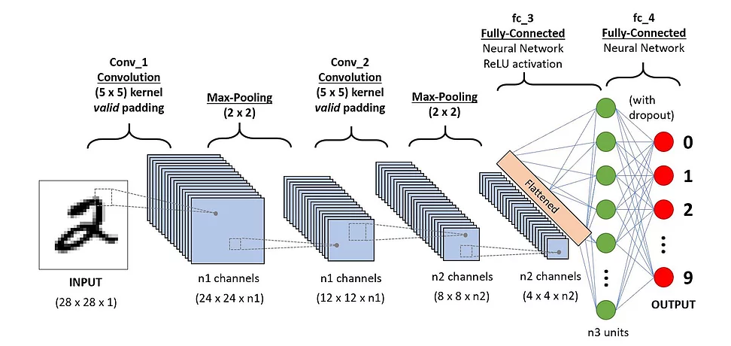
Constituent Layers of CNN
Pre-processing Layer
Convolution Layer
Pooling Layer
Non-Linearity
Fully-Connected Layer
Softmax Layer
Feature Extraction
Classification

Slide 14
Pre-processing
Image set is divided into training set and testing set
The images are flattened and the pixels are put into an array
Reduce the noise in the image

Slide 15
Convolution Layer
Using convolutions on images is like scanning over it with a magnifying glass.
Convolution operation i.e. a dot product is applied between input and kernel
It is denoted by *
A “kernel” passes over the image, scanning a few pixels at a time and creating a feature map that predicts the class to which each feature belongs

Slide 16
Kernel/Filter
Each filter in a convolutional layer is a grid of discrete numbers.
Filters are usually of the size 3x3, 5x5, 7x7
It asks a question to the image- Do you have what I am looking for??
When filter is placed on the image then the convolution is basically the middle pixel being estimated using the surrounding pixels

Slide 17
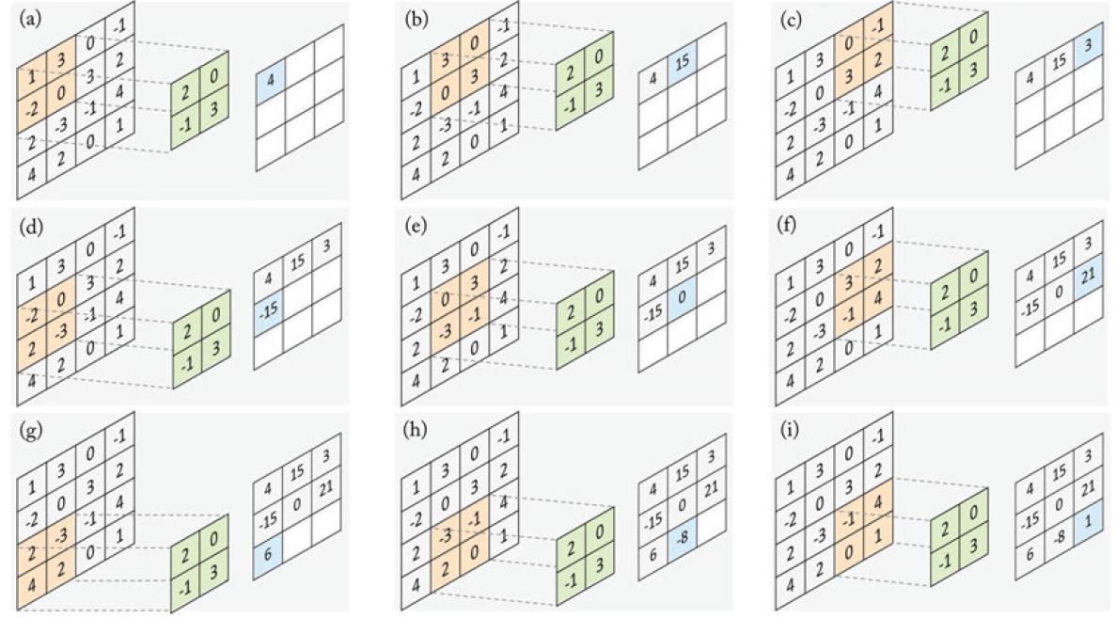
2-D Convolution operation 4x4 input and 2x2 filter

Slide 18
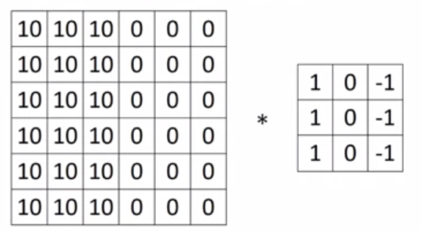
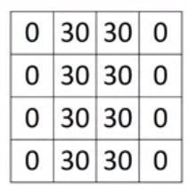
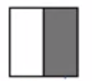
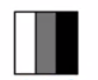
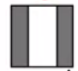
An Example- Vertical edge detection
=
10 is white colour pixel value
0 is grey colour pixel value
-1 is black colour pixel
*
=
This looks for difference in pixel values

Slide 19
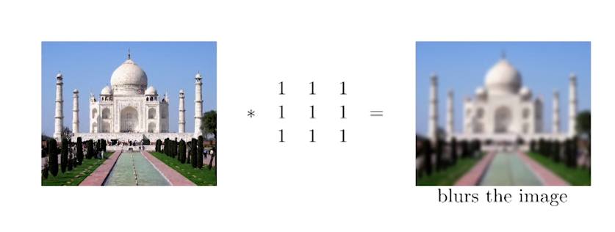
Blur Filter

Slide 20
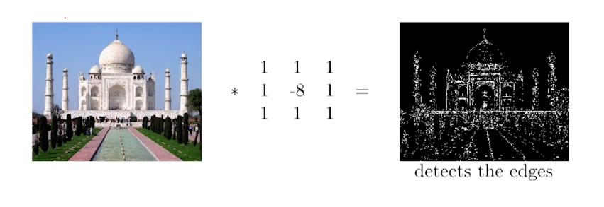
Edge Detector filter

Slide 21
Hyperparameters in Convolution Layer
Hyperparameters are the variables which determine the network structure and the variables which determine how the network is trained. They are set before training.
In Conv layer they are:
Number of filters
Filter size
Padding
Stride

Slide 22
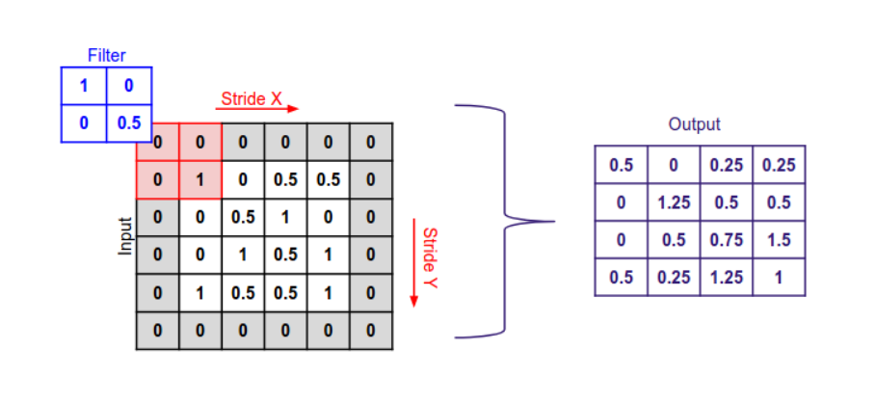
Padding
It is the amount of zero value pixels to be added to the image
Pad because- when a small image goes through a deep CNN then it would diminish early on after a few conv layers, a problem!!
Padding is added to make the output size to be the same as the input image
Mostly zero value pixels are added as padding so it is also known as zero padding

Slide 23
Stride
It is the amount of pixels by which the filter moves over the image
Different stride values can be provided for horizontal and vertical directions
The more the stride, smaller the output image size
In the conv layer example stride of 1 has been taken

Slide 24
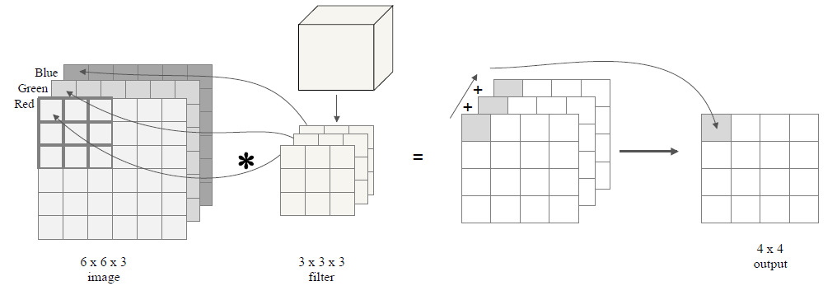
Example with multiple channel image

Slide 25
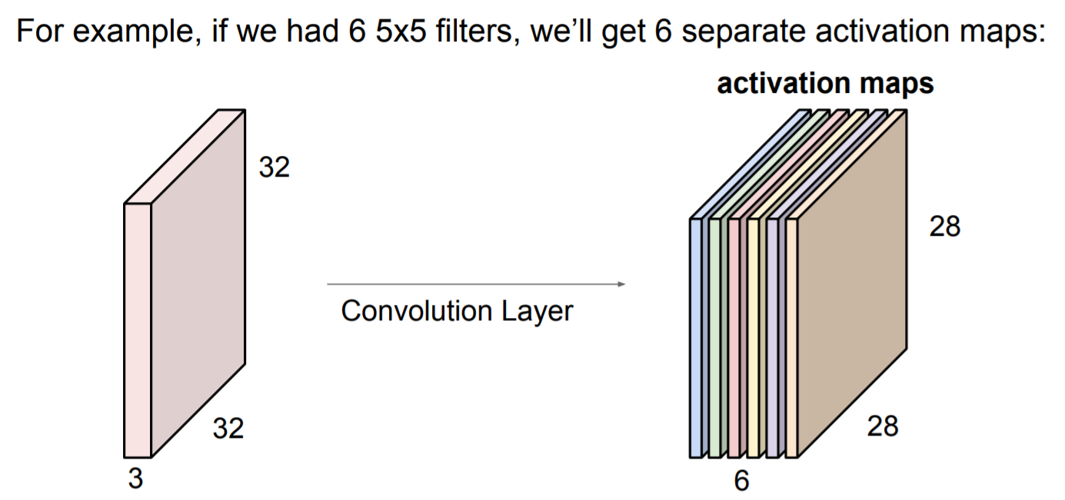
Example with multiple number of filters

Slide 26
Pooling Layer
Reduces the amount of information in each feature obtained in the convolutional layer while maintaining the most important information
Pooling layers section would reduce the number of parameters when the images are too large.
Spatial pooling is called subsampling or down sampling which reduces the dimensionality of each map Spatial pooling can be of different types:
Max Pooling- Calculate the maximum value for each patch of the feature map.
Average Pooling- Calculate the average value for each patch on the feature map.

Slide 27
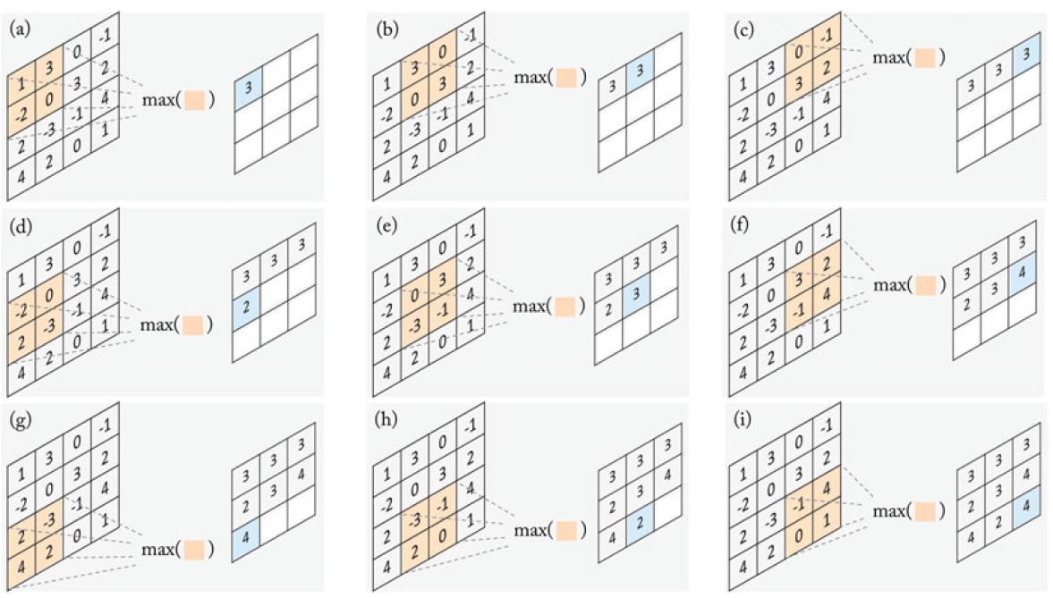
Pooling Layer- Max Pooling

Slide 28
Non-Linearity Layer
The weight layers in a CNN are followed by a nonlinear activation function
Nonlinear function - it allows a neural network to learn nonlinear mappings
A nonlinear function is a switching or a selection mechanism, which decides whether a neuron will fire or not given all of its inputs.
The activation function takes a real valued input and squashes it within a small range such as [0, 1] and [1, 1].
In the absence of nonlinearities, a stacked network of weight layers is equivalent to a linear mapping from the input domain to the output domain, which will be of no use
The activation functions used in deep networks are differentiable to enable error back propagation

Slide 29
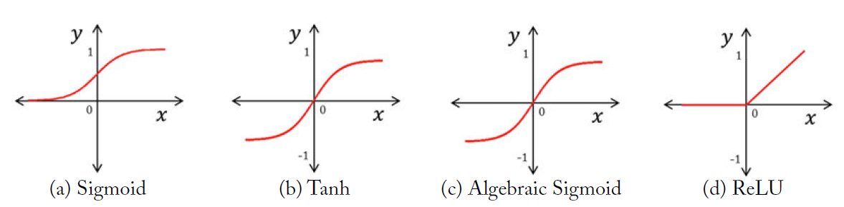
Some non-linear activation functions

Slide 30
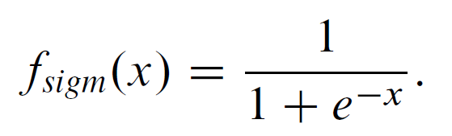
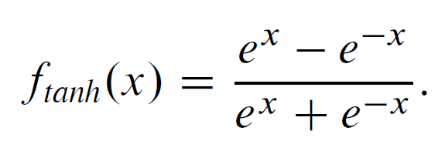
Sigmoid Function
Tanh Function
The sigmoid activation function takes in a real number as its input, and outputs a number in the range of [0,1]. It is defined as:
The tanh activation function implements the hyperbolic tangent function to squash the input values within the range of [-1, 1].

Slide 31
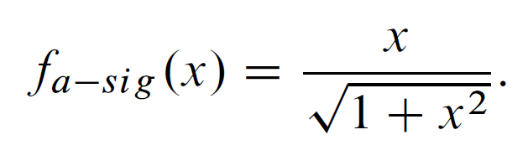
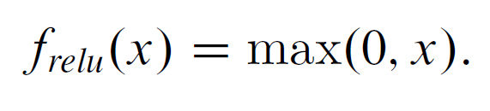
Algebraic Sigmoid Function
Rectified Linear Unit
The algebraic sigmoid function also maps the input within the range [-1,1].
The ReLU is a simple activation function which is of a special practical importance because of its quick computation. A ReLU function maps the input to a 0 if it is negative and keeps its value unchanged if it is positive. This can be represented as follows:

Slide 32
Fully-Connected Output Layer with Softmax Function
Fully connected layers connect every neuron in one layer to every neuron in another layer.
It is in principle the same as the traditional multi-layer perceptron neural network (MLP).
The flattened matrix goes through a fully connected layer to classify the images.
Softmax function, an activation function that turns numbers in fully connected layer into probabilities that sum to one.
It is used when there are multiple classes for classification
Softmax function outputs a vector that represents the probability distributions of a list of potential outcomes.

Slide 33
Let’s put it all together

Slide 34
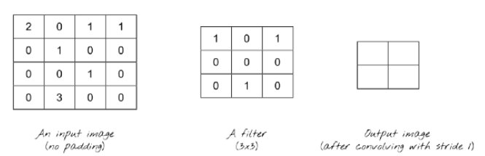
Example:
Let’s start with a (4 x 4) input image with no padding and we use a (3 x 3) convolution filter to get an output image.

Slide 35
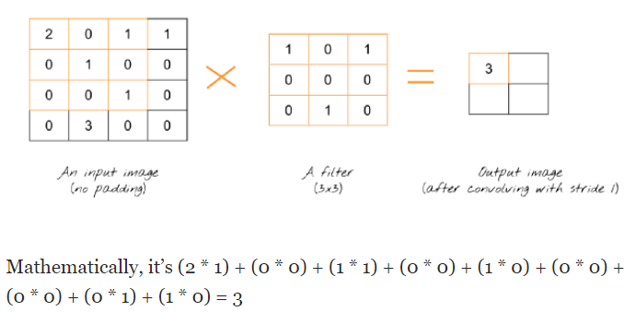
Example:
The first step is to multiply the yellow region in the input image with a filter. Each element is multiplied with an element in the corresponding location. Then you sum all the results, which is one output value.

Slide 36
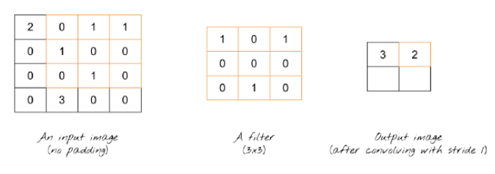
Example:
Then, you repeat the same step by moving the filter by one column. And you get the second output.

Slide 37
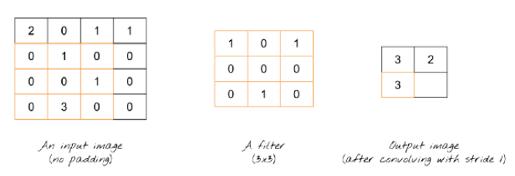
Example:
Notice that you moved the filter by only one column. The step size as the filter slides across the image is called a stride. Here, the stride is 1. The same operation is repeated to get the third output. A stride size greater than 1 will always downsize the image. If the size is 1, the size of the image will stay the same.

Slide 38
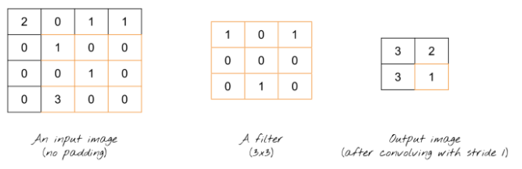
Example:
At last, you are getting the final output.

Slide 39
Example:
Pooling
Note that pooling is a separate step from convolution. Pooling is used to reduce the image size of width and height. Note that the depth is determined by the number of channels. As the name suggests, all it does is it picks the maximum value in a certain size of the window. Although it’s usually applied spatially to reduce the x, y dimensions of an image.

Slide 40
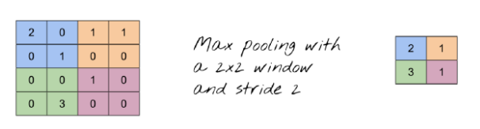
Example:
Max-Pooling
Max pooling is used to reduce the image size by mapping the size of a given window into a single result by taking the maximum value of the elements in the window.

Slide 41
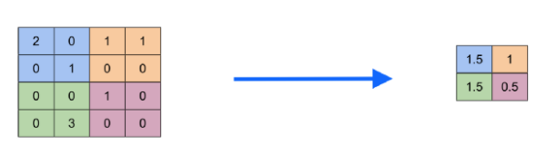
Example:
Average-Pooling
It’s same as max-pooling except that it averages the windows instead of picking the maximum value.

Slide 42
CNN can also work on
Audio classification
Text Classification

Slide 43
References https://towardsdatascience.com/a-comprehensive-guide-to-convolutional-neural-networks-the-eli5-way-3bd2b1164a53 https://www.youtube.com/watch?v=FmpDIaiMIeA&t=449s https://towardsdatascience.com/a-beginners-guide-to-convolutional-neural-networks-cnns-14649dbddce8

Slide 44
Thank You

